Slide 1
Enterprise Architecture
Group Name/NO.
Date

Slide 2
Introduction
The Open Group Enterprise Framework (TOGAF) is a system which organizations seeking to incorporate the enterprise architecture model in their operations can find useful in improving their efficiency.
Organizations have modified the system for greater alignment their IT framework and their business concerns.
TOGAF seeks to optimize processes into an integrated environment.
Such an environment responds positively to change
It also facilitates the delivery of the business strategy.
Notes:
The TOGAF standard is developed and maintained by members of The Open Group, working within the Architecture Forum. Today's CEOs know that the effective management and exploitation of information and Digital Transformation are key factors to business success, and indispensable means to achieving competitive advantage. TOGAF addresses this need, by providing a strategic context for the evolution and reach of digital capability in response to the constantly changing needs of the business environment.
Source: Open Group (2019). The TOGAF® Standard, Version 9.2. Retrieved from http://pubs.opengroup.org/architecture/togaf9-doc/arch/index.html

Slide 3
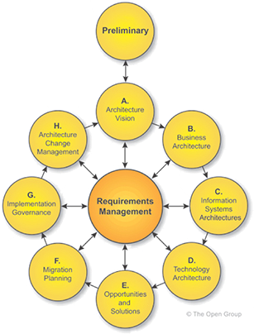
Introduction Cont…
Basic structure of TOGAF framework
Notes:
As displayed in the diagram, TOGAF apply all the domains of business i.e. the technical, data, business management, and applications parts. It outlines the vision and the steps to achieve that vision starting from modification to suit the business architecture, the information systems and the technologies. It then analyze the opportunities and solutions, provide a plain for migration into the new system, outlines the implementation governance and finally facilitates the change management.
Source: Open Group (2019). The TOGAF® Standard, Version 9.2. Retrieved from http://pubs.opengroup.org/architecture/togaf9-doc/arch/index.html

Slide 4
Summaries of Case studies Cont…
Some of the organizations that utilize TOGAF include Westpac, QA Consulting Firm, and Litton PRC.
Westpac, Australia
  Westpac is a banking corporation that offers financial services in Australia.
  Its headquarters are based at Westpac place in Sidney.
  Company needed a framework to guide their architectural transformation to encourage/reinstate their marketplace authority and encourage banking innovation (Open Group, 2019).
  The company used TOGAF to solve the problem of baseline data collection.
Notes:
The company’s data collection involved documentation, interviews, and review current products and services portfolio. Apparently, they were experiencing data overlap and gaps which complicated the analysis part. They were thus seeking a system model to alleviate this problem (Open group, 2019).
They are using the system to Populate their business model and embed it into the way they describe and think about standards
Source: Open Group (2019). Case Studies. Retrieved from http://www.opengroup.org/public/arch/p4/cases/case_intro.htm

Slide 5
Summaries of Case studies Cont…
Through the system, Westpac was able to:
  have a common reference point internally and for its vendors.
  Ready-made structure for governance.
  Accelerated our ability to implement the necessary disciplines that any model should enable.
  argue about interpretation but not about the basics.
Notes:
Source: Open Group (2019). Case Studies. Retrieved from http://www.opengroup.org/public/arch/p4/cases/case_intro.htm

Slide 6
Summaries of Case studies Cont…
QA Consulting Firm
This is a UK consultancy and training company whose mission is to improves IT effectiveness within large organizations .
The increased tech application in the organization had caused an overlap of initiatives and parallel programs.
An IT strategy was devised to align business, IT, and prioritize investments.
TOGAF was the blueprint for implementing the strategy.
The program reduced the cost of operation, improved the speed to market, and facilitated business innovation in the organization.
Notes:
They focus on enhancing the skills of people, optimizing human capital investment and providing IT expertise that complements in-house skills.
The IT strategy defines what needs to be done and, through explicit linkage to the business, why this needs to happen and when. It is explicitly linked to the future business direction. It is:–A Framework for Decision-making–A Process for alignment of Business & IT–A set of Strategic Options–A set of aligned Business & IT projects/initiatives
Source: Open Group (2019). Case Studies. Retrieved from http://www.opengroup.org/public/arch/p4/cases/case_intro.htm

Slide 7
Summaries of Case studies Cont…
Litton PRC
An information systems company situated in McLean, Virginia.
Chose TOGAF as a basis for its revamped internal Architecture Design Process.
Eventually, New Automated Patent System (APS) architecture was completed with improvements incorporated
Litton PRC concluded that T.OGAF ADM is a base document for start up of a new program.
Notes:
ADM concepts used to extend to internal Architecture Process within Systems Engineering Practice at Litton PRC during the redesigning of the US Patent &Trademark Office project (Open Group, 2019).
The company chose TOGAF ADM as a reasonable methodology as the project personnel was technically familiar with APS.
Source: Open Group (2019). Case Studies. Retrieved from http://www.opengroup.org/public/arch/p4/cases/case_intro.htm

Slide 8
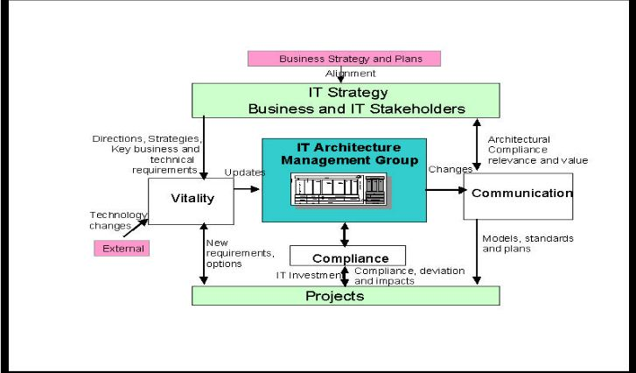
Evaluation of the Organizations Cont…
Westpac put the IT management group at the centre
All the other aspects of the system had to pass through the management group.
Allowed ease of communication and compliance
What did they do wrong?
The process was not free-flowing
Little attention to tech changes
Absence of free data flow across
departments
Notes:
With the architecture management group being at the centre of operations, Westpac was using to rule all the elements of the architecture in the organization. This aided in an effective and efficient management of interconnections of the framework.
The fact that every other department had to get involved with the architecture group ensured sharing of information on what was happening in the organization and allowed everyone to remain update. The central monitoring process ensured compliance to the proposed framework across the departments.
External technology changes were thrown at the periphery of the system meaning they lacked significant impact in the system. new developments in the tech world would impact the performance of architectural framework. Data and information flow across all the department lacks with every department relying on what the central management group feed them. Data from all the departments should be available for everyone in the organization to ensure the objectives of the business are achieved.

Slide 9
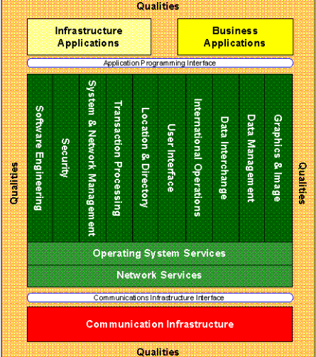
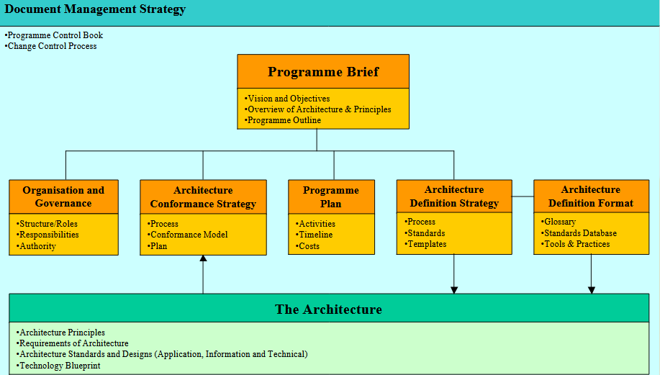
Evaluation of the Organizations Cont…
QA Consultancy firm explicitly linked the TOGAF model to its future business direction
c 2001Copyright QA plc 2001Copyr
Copyright @QA plc 2001
Notes:
QA consultancy utilized Reference models that was key in the evaluation of their design performance and also provided a visual picture of the project implementation specifications.
System components were clearly defined and arranged on how they were going to fit in the IT strategy. However, there was no central control unit for the architectural group would facilitate greater efficiency and effectiveness as observed in Westpac corporation.

Slide 10
Evaluation of the Organizations Cont…
    Litton PRC used a project personnel that was knowledgeable, technically proficient & familiar with APS
    Also technically proficient in architecture definition
    All staffs had an idea of the goals
    Staff training
                Failed to perform Business Transformation Readiness Assessment.
                Interoperability Requirements.
                Architecture Patterns
Notes:
Before the architecture implementation, there was extensive team training leaving them the company’s staffs anxious to try the new method and its processes. For training, they picked an architectural team that understood the general goals of Litton PRC and were experienced in the process definition (Open Group, 2019).
QA consultancy lacked a central management control but its framework was the best; it installed a reference model to keep it in check, adhered to the definition of the baseline frameworks i.e. business, technical, data, and applications architecture
Westpac adhered to interoperability requirements in its project implementation unlike Litton PRC but failed to use a valid implementation plan where personnel was to be vetted and staffs trained.
The architectural personnel were proficient in APS functioning and were familiar with details of existing implementation with subject matter experts.
However, the organization did not perform a transformation readiness assessment, but rushed to execute the project after training the relevant personnel; they ought to have first tested the system viability for the organization or else they might need to run systems upgrade in the future after the current one loses its viability (Schmidt & Buxmann, 2011).
The company also failed to present a visual representation of the architectural design living outsiders and those who never went for training in the dark. There was no definition of interoperability requirements i.e. how information was to be shared across the processes and the technical aspects of the entity.
Source: Schmidt, C., & Buxmann, P. (2011). Outcomes and success factors of enterprise it architecture management: Empirical insight from the international financial services industry. European Journal of Information Systems, 20(2): 168-185.

Slide 11
Considerations for the(CIO)Cont…
    The CIO ought to consider some dynamics before settling on TOGAF as the organization’s architectural framework.
    Benefits
    Ability to help people propose, document, plan and govern systems within an organization.
    Broad and free to read, thereby enabling the acquisition of knowledge in broad perspectives
    Developed by a large community, thereby presenting a common language about the process followed by architects in different organizations.
    An enterprise-based approach, which addresses the IT needs of each organization
Notes:
TOGAF is considered as one of the most commonly utilized EA today (Kotusev, 2018). Some of its advantages include the ability to help people propose, document, plan and govern systems within an organization. TOGAF is broad and free to read, thereby enabling the acquisition of knowledge in broad perspectives. TOGAF is developed by a large community, thereby presenting a common language about the process followed by architects in different organizations. Being flexible, TOGAF provides an enterprise-based approach, which addresses the IT needs of each organization. The ability to harmonize different departments enables TOGAF to increase the cross-organizational standardization and integration of systems and processes. Consequently, TOGAF coordinates business process improvement.
Source: Kotusev, S. (2018). TOGAF-Based Enterprise Architecture Practice: An Exploratory Case Study. Communications of the Association for Information Systems, 43 (20): 321-359.

Slide 12
Considerations for the(CIO)Cont…
    Cross-organizational standardization and integration of systems.
    Coordinates business process improvement.
    Limitations
    Assumes that firms already have their processes for the related disciplines.
    Most TOGAF recommendations are usually found inapplicable.
    Real examples demonstrating the actual practical usage of TOGAF's recommendations are missing.
Notes:
TOGAF assumes that firms already have their processes for the related disciplines; hence automatic integration of the processes into TOGAF once installed.
Research evidence shows that "most TOGAF recommendations are usually found inapplicable" and not followed even in the organizations included in the list of TOGAF-users provided by The Open Group. That is why TOGAF can be considered only as "a toolkit of random EA-related recommendations" and "‘using TOGAF’ can be best explained as ‘studying TOGAF and then doing something else instead. There is a pressing need for some detailed worked examples and use cases. Although these were requested, they were not forthcoming from TOGAF trainers or The Open Group (Anderson et al., 2009).
Source: Anderson, P., Backhouse, G., Townsend, J., Hedges, M. and Hobson, P. (2009). Doing Enterprise Architecture: Enabling the Agile Institution. Bristol, United Kingdom: Joint Information Systems Committee (JISC).)

Slide 13
Considerations for the(CIO)
  Determining the Best Fit for the Organization
Before deciding to utilize architectural development model, the CIO needs to gain some experience with TOGAF.
There are two choices on how to can get this experience.
    The organization can train itself in TOGAF
    The organization can also buy expertise in TOGAF
The company would be best placed to choose buying the expertise to minimize chances of failure.
Notes:
In training itself, the organization can download the TOGAF documentation, which describes all of TOGAF, including the ADM, in considerable detail. It can purchase books on TOGAF There is probably more free and inexpensive available information about TOGAF than about all other architectural methodologies combined Perks & Beveridge, 2007).
In deciding to buy the expertise, there are consultants who specialize in TOGAF and have earned Open Group certification. Because the CIO wants to minimize any chances of failure, the appropriate choice is to go for a TOGAF consultant.
Source: Perks, C., & Beveridge, T. (2007). Guide to enterprise IT architecture. Springer Science & Business Media.

Slide 14
Considerations for the(CIO)Cont…
Implementation Planning and Success Criteria
In planning to Implement the system, the CIO meets with the major players in the organization to introduce the TOGAF process. Three goals in the preliminary phase are to:
    Make sure everybody is comfortable with the process.
    Modify the TOGAF process, as necessary, to fit within the organization’s culture.
    Set up the governance system that will oversee future architectural work
Notes:
In some organizations, achieving buy-in on the need for an enterprise architecture could be very difficult. This is especially true when the effort is driven from the IT organization, and even more so when there is a history of discord between the business and the technical sides of the organization. However, the fact that the implementation would be run by the CIO gives the project high visibility and creates a positive incentive for cooperation from all sides.

Slide 15
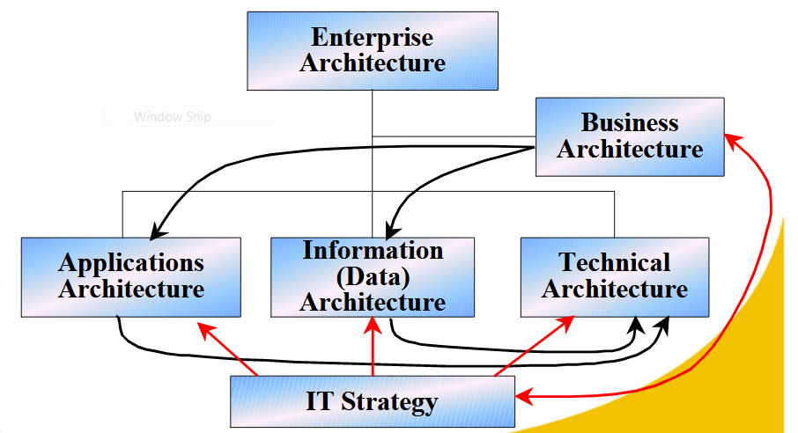
Considerations for the(CIO) Cont…
The CIO ought to ensure that the project has the necessary support within the organization to warrant its success by defining the baseline architecture. Baseline Architecture
Copyright @QA plc 2001
Notes:
The CIO will ensure that the project has the necessary support within the organization, define the scope of the project, identify constraints, document the business requirements, and establish high-level definitions for both the baseline (starting) architecture and target (desired) architecture.
The baseline architecture include the four sub-frameworks for enterprise architecture namely business, technical, data, and application architectures.

Slide 16
Considerations for the(CIO) Cont…
    Identify the major projects that might be implemented and evaluate the business opportunity associated with each.
    The projects should be ordered in terms of costs, benefits, and risk factors.
    There should be architectural specifications to guide the chosen implementation project.
Notes:
In evaluating the various implementation possibilities, the CIO should identify the major implementation projects that might be undertaken, and evaluates the business opportunity associated with each. According to The TOGAF standards, focus should be on projects that will deliver short-term payoffs and so create an thrust to proceed with longer-term projects.
Therefore, the CIO should be looking for projects that can be completed as cheaply as possible, while delivering the highest perceived value.
Architectural specifications for the implementation projects will include acceptance criteria and lists of risks and issues.

Slide 17
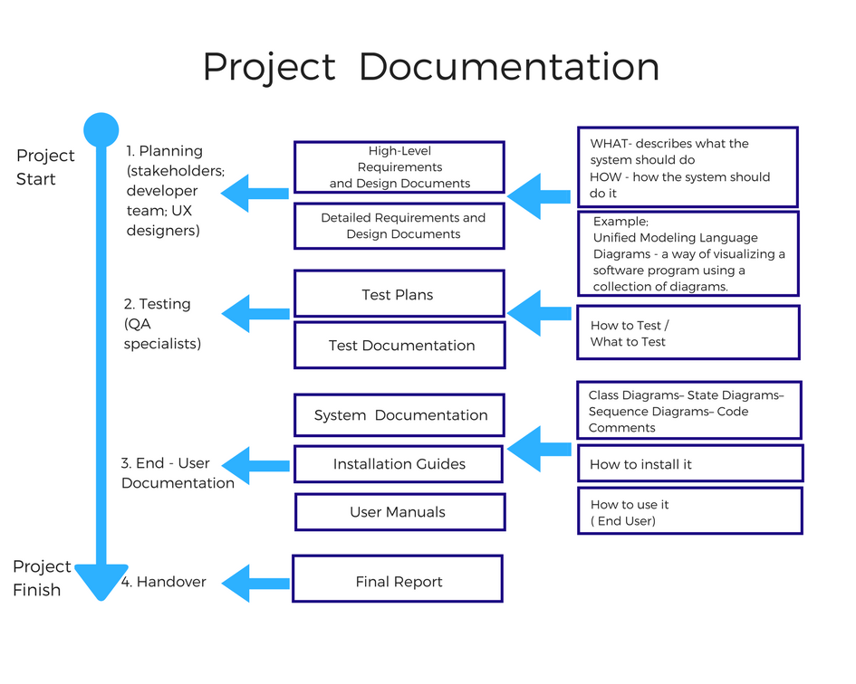
Considerations for the(CIO) Cont…
Documentation criteria for Implementation planning
Notes:
Documentation exists to explain product functionality, unify project-related information, and allow for discussing all significant questions arising between stakeholders and developers.
The documentation types that the team produces and its scope depend on the Architectural development method that was chosen.

Slide 18
Positioning of the Organizations for Architecture Capability Cont…
The organization of enterprise architecture should reflect the organization of the business.
The company should analyze and measure the effects of enterprise architecture on the business.
QA Consultancy, being an IT service provider, utilized TOGAF as it is the most IT specific architectural framework that is easily modifiable to suit an Organization’s objectives
Litton PRC used TOGAF to develop a new Automated Patent System architecture; this was possible as the system they adapted matched their SE lexicon and linked the process to others.
Therefore , there should be a hook that connect the architectural framework to the objectives of an organization.
Notes:
The organization of enterprise architecture should reflect the organization of the business. For instance, there is no need for a central EA department for a financial holding company that owns a telecommunications company and a retail bank. Actually, trying to synchronize the technologies and processes across these very different businesses would likely generate more inefficiencies than solutions.

Slide 19
Conclusion
The organization of an architectural framework is only successful if it aligns with the organization buying it.
Case studies have reflected this with their success depending on the architectural method fitness.
Before implementation, a number of considerations ought to be assessed, especially the benefits, the limitations, the implementation planning, and the positioning of a company to enable the architectural design.

